Slide 1
Mobile Technology in Court Management

Slide 2
BENEFITS
Cost Effective
Environment Friendly
Reduces Litigant/Public footprints thereby reducing load on infrastructure
Transparency
Procedural Simplification
Increased Efficiency and Productivity
Save Manpower Cost
Saves Processing Time

Slide 3
TECHNOLOGIES
Advancement of Technology has eroded the thin line between Desktop, Web & Mobile Technologies.
Mobile Technology can be used for almost all the purposes for which desktop were being used along with web.
Features like GPS Navigation, SMS Services, Group Chats (WhatsApp ) & Video Conferencing facilities through soft Video Conferencing applications such as Vidyo, Skype has made Mobile technology more user friendly with widespread applications.

Slide 4
Mobile Technology can be used to enable Court Staff , Litigants, Advocates as well as Judges

Slide 5
ENABLING ADVOCATES
Advocates being part of Justice Delivery System needs to be empowered with information for better Assistance to the Court

Slide 6
e-Diary : Cause List & Case Management.
e-Filing
Online Availability of Scanned Paperbooks
  Availability of Online Paperbook to office of Advocate General, Counsel for Union of India and to other Government Departments.
Electronic Memo of Appearance
e-Stamping
e-Inspection
SMS Services informing Filing Status , Case Status, Disposal Status, Inspection Application Status and Certified Copy Status.
  SMS Pull and Push Services
  IVRS System
Online Current Case Status
Case Search
Caveat Search
Availability of Indian Law Reports Online.
Navigation Application for Locating Court Complexes
Availability of Notices online
Online Traffic Challan Payment Portal

Slide 7
e-DIARY : MANAGEMENT OF CASE
A Case Management Module (e-Diary) whereby the members of the Bar / Government Departments can be permitted to add cases against the user IDs assigned to them.
The cases added by User are then reflected in that User Account which enables the concerned user to manage and print his Cause List and know status of cases added in his account. Next date, purpose for which case is fixed and Interim Orders are available to the user.
Case is updated in Real Time as and when it is updated by court.
It acts as Electronic Diary for Advocate being updated by Court itself.
It eliminates chances of missing a case as Status of case is in sync with Court Records.

Slide 8
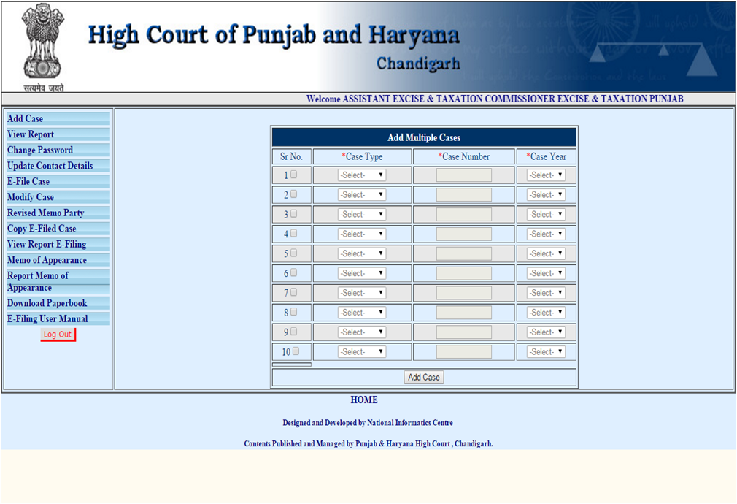

Slide 9
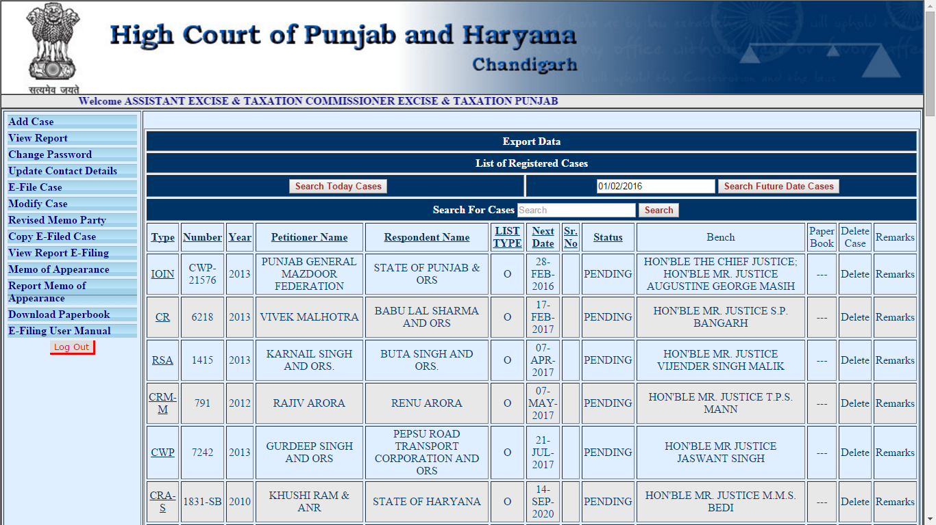

Slide 10
e-FILING
Through e-Diary Module Advocates have been enabled to file Petitions / Appeal / Applications online .
E-Filing in turn would facilitate entry of Case Records thereby reducing workload of Court officials and will ensure availability of scanned/soft paperbooks.
Availability of soft paperbooks duly digitally signed would further reduce unnecessary hard copies of paperbooks
User can create and View Uploaded Memo of Party, Index, Paperbook, Documents, FIR Details, Lowercase details etc.
Party Details filed by Advocates can be used for generating Notices and sending them through email to the opposite site thereby eliminating delays.

Slide 11
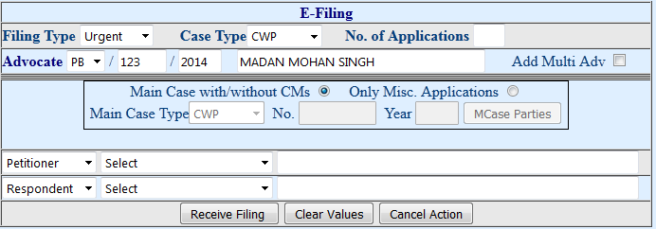
e-Filing Screen : After Login

Slide 12
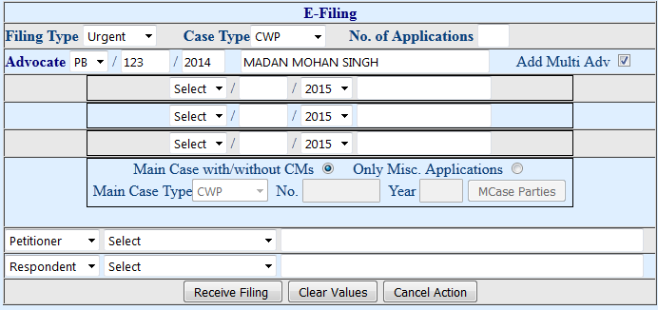

Slide 13
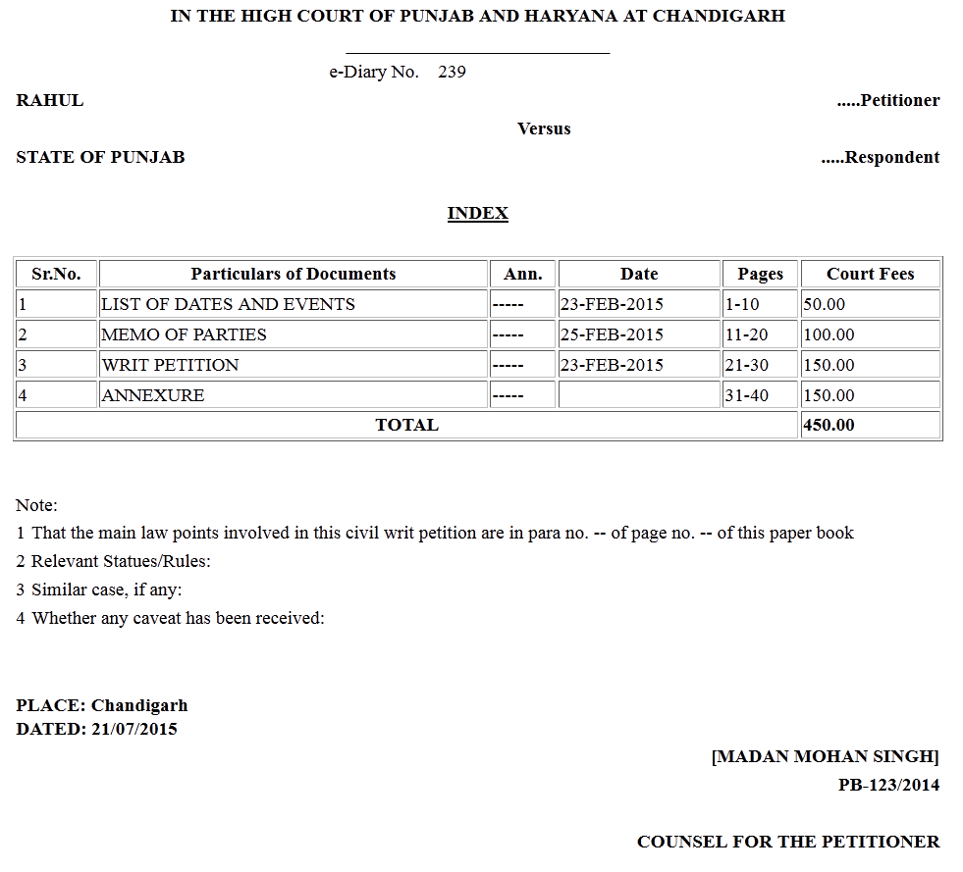
INDEX PRINTOUT

Slide 14
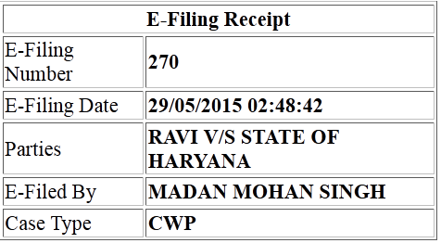
e-FILING RECEIPT

Slide 15
ACCESS TO SCANNED PAPERBOOKS TO ADVOCATES, ADVOCATE GENERAL, COUNSEL FOR UNION OF INDIA AND OTHER GOVERNMENT DEPARTMENTS
&
ONLINE MEMO OF APPEARANCE
  eDiary allows online access to paper-books.
  Advocates / Departments having eDiary Account are allowed to download entire paperbook of cases which are filed online or where advocate has filed electronic Memo of Appearance.

Slide 16
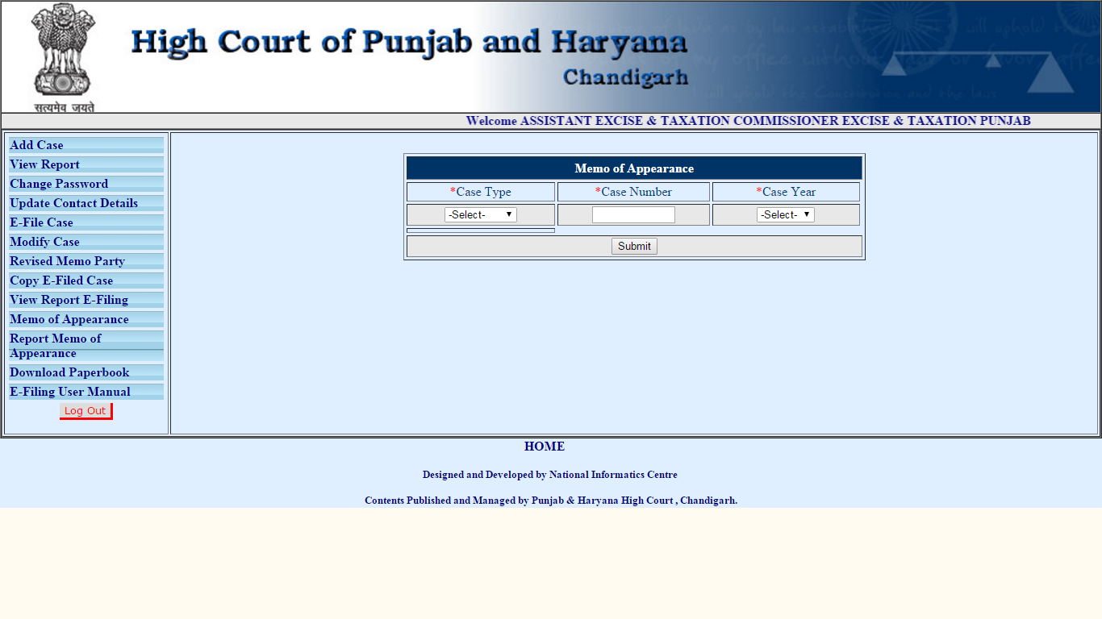

Slide 17
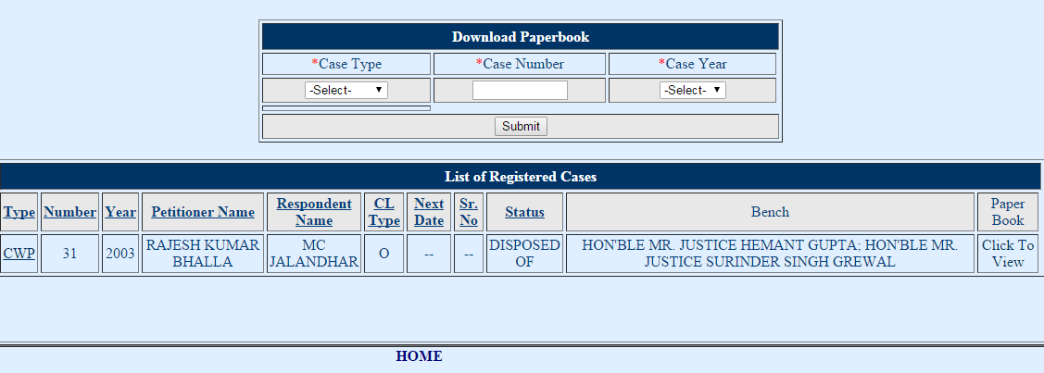

Slide 18
e-INSPECTION
Inspection of Court files to party can be allowed through online mechanism as is being done in Punjab and Haryana High Court where paperbook is being made available to the counsels of parties through e-Diary.
Actual file movement is eliminated.

Slide 19
SMS ON VARIOUS STAGES
Filing of case
Objection
Registration of case
Next Date
Disposal of case
Certified Copy Status
  Filing
  Prepared
  Delivered
Inspection Status

Slide 20




SMS SERVICES
SMS NOTIFICATION FOR CASE STATUS AT HIGH COURT & District Courts
HIGH COURT & DISTRICT COURTS
FILLING
OBJECTION
REGISTRATION
NEXT DATE

Slide 21

SMS SERVICES
SMS NOTIFICATION FOR CERTIFIED COPY AT HIGH COURT
COPY
HIGH COURT
FILLING
PREPARED
DELIVERED

Slide 22
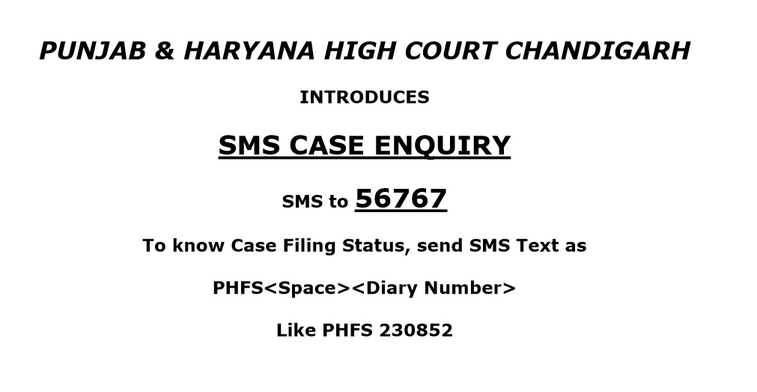
SMS PUSH AND PULL SERVICES
In order to help the general public who is not computer savvy mobile application called Short Messaging Service, better known as SMS, can been integrated with the system so as to provide a powerful tool to the litigant public for information gathering.
By the use of this service one can know status of his case.

Slide 23
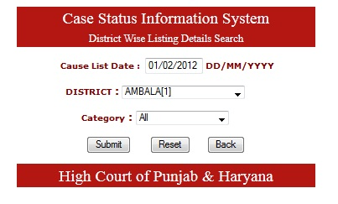
ONLINE CURRENT CASE STATUS
Online Mobile application provide various information pertaining to a case.
Also status of case can be retrieved using various search parameters .

Slide 24
CURRENT STATUS OF CASES
ON MOBILE
Display Board can be made available on mobile. One can view Display Board online which shows all the Courts along with the cases being heard in each Court at that time with a delay of 30 seconds. It Displays all the Serial Numbers of the cases currently running in the Courts.
It also shows case details along with interim ordres.

Slide 25
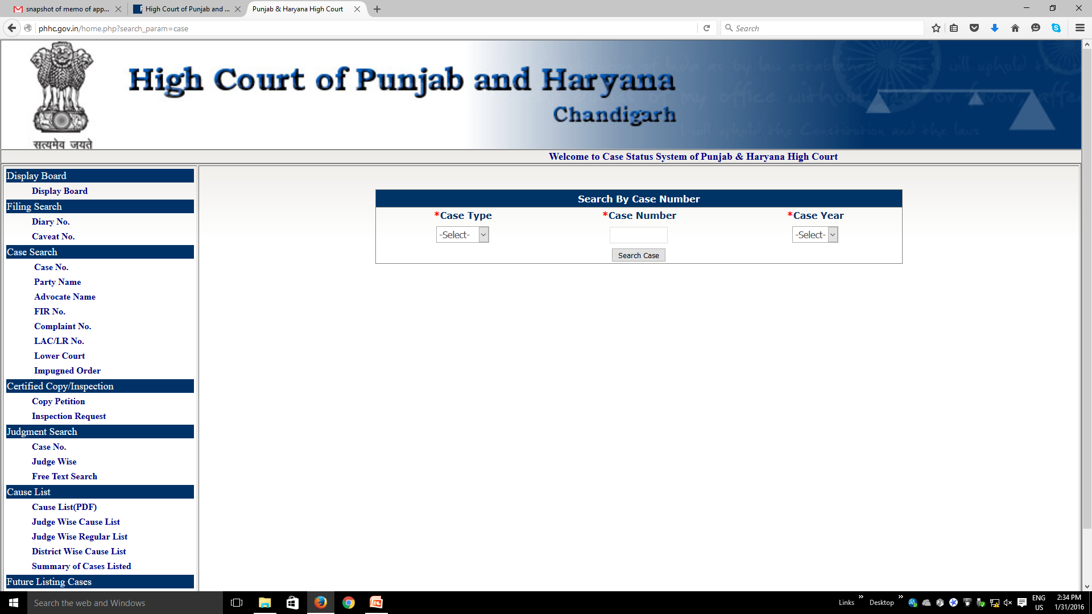
CASE SEARCH

Slide 26
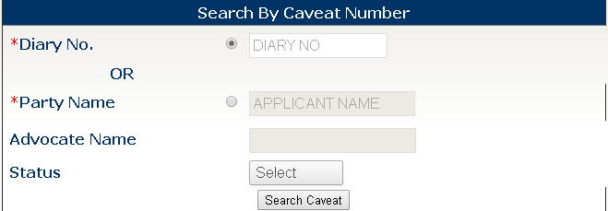
CAVEAT SEARCH
Unique number is assigned to Caveats after registration. The updated status is sent to concerned advocates through SMS.
Caveat can be searched on parameters like petitioner name, advocate name.

Slide 27
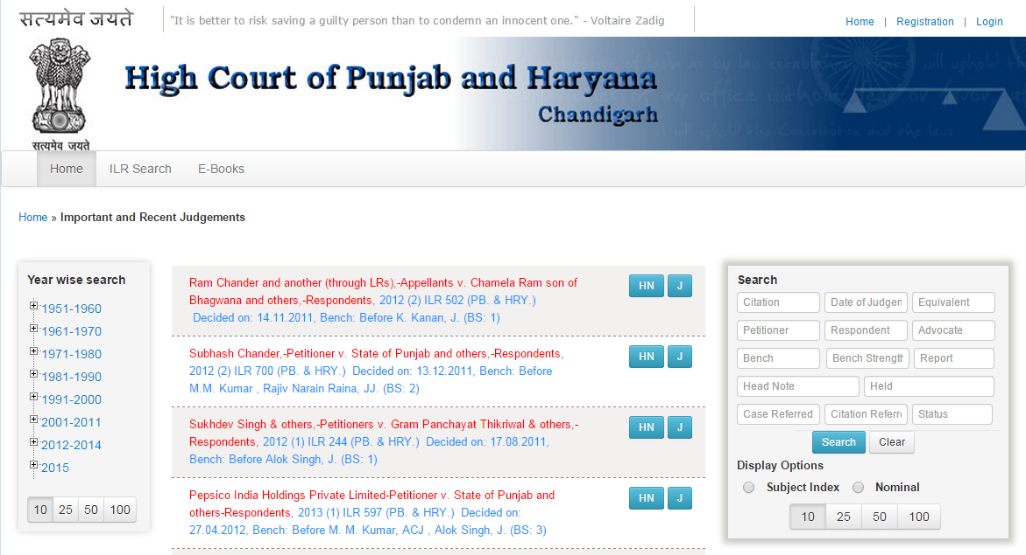
AVAILABILITY OF INDIAN LAW REPORTS ONLINE
Indian Law Reports (Punjab and Haryana) Series from 2012 onwards has been digitalized.
True printouts of ILR with search option as well as e-Book shall be available free of cost to litigants and advocates.

Slide 28
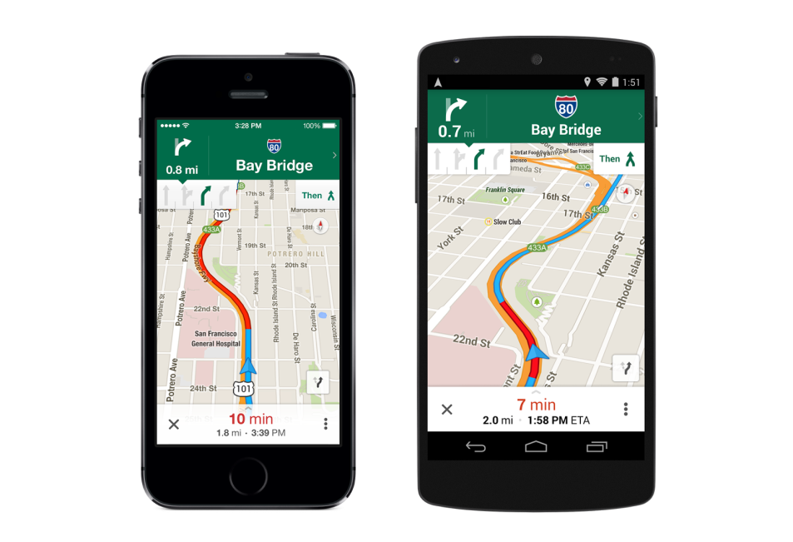
NAVIGATION APPLICATION FOR LOCATION COURT COMPLEXES
Through Mobile app court complexes can be located and it displays the direction to that specific court complex making use of Google Maps.
Also direction and distance of other court complexes can be retrieved.

Slide 29
e-NOTICES
Features:
All types of notices (i.e.. court notices, sale notices and advertisements) can be made available through online portal / mobile application.
Saves cost to be incurred on publication in newspaper.
Fully Searchable

Slide 30
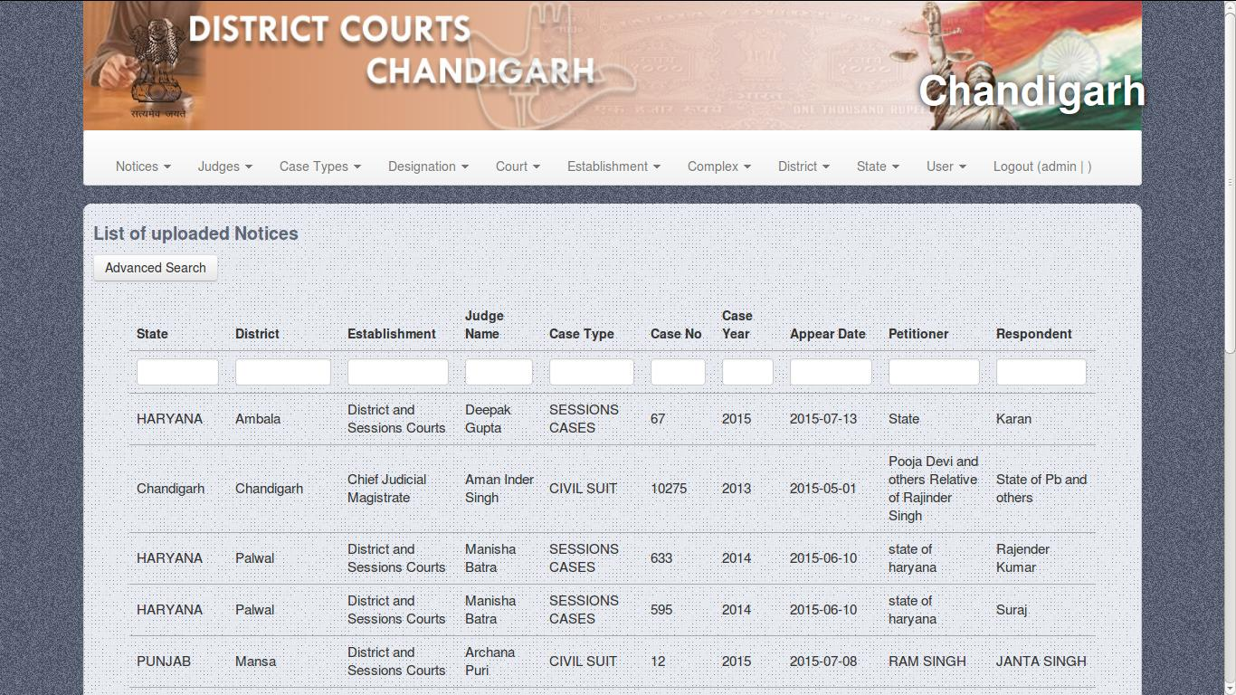

Slide 31
ENABLING LITIGANTS
Justice Delivery System needs to be litigant centric. Litigants needs to be empowered with information.

Slide 32
CASE RELATED SERVICES AVAILABLE FOR LITIGANTS
Case Status
Case Search
Caveat Status
Certified Copy
Current Case Status on mobile with complete detail of case
Can be made available through SMS or mobile application.

Slide 33
AVAILABLITY OF COURT JUDGEMENT / INTERIM ORDERS / CASE STATUS THROUGH MOBILE APPLICATION
Minimize use of paper & saves environment.
Cost effective – Saves money.
Reduces footfall in courts
Leads to better preparation of case and assistance to court.

Slide 34
ENABLING OFFICERS
For effective adjudication Judicial Officers needs to be empowered with information and ease to work with aid of mobile technology,

Slide 35
ENABLING OFFICERS AND OFFICIALS
PIS
Postings / Transfers
Gradation Lists
Property Details
Annual Self Appraisal
Leave
LTC

Slide 36
PIS : PERSONNEL INFORMATION SYSTEM
Transfer and Posting’ Details (since joining of the service)
Availability of Annual Confidential Reports
Property Details can be managed online.
Leave and Salary details can be managed online.
Availability of Gradation List.
All the transfer & posting orders can viewed online.

Slide 37
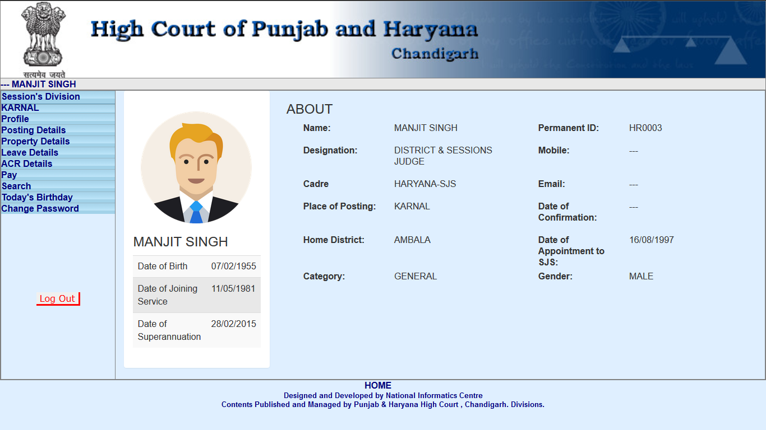

Slide 38
e-Reporting
Various Vital Reports are being collated and available on a single tap of mobile using e-Reporting App.
This app can helped Officers in strategic planning and decision making .
Various customized Reports can be made available using this e-Reporting App.

Slide 39

REDUCED USE OF PAPER. AGENDA OF FULL COURT MEETING
The agendas of the Full Court meetings and other meetings are being sent through mails to the Hon'ble Judges, which has resulted in saving a lot of paper.

Slide 40
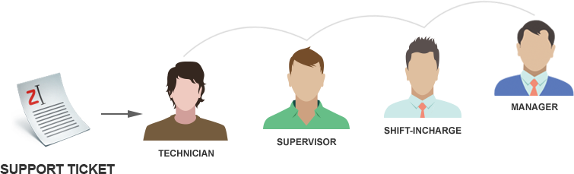
COMPLAINT MATRIX FOR EFFICIENT FAULT ESCALATION & RESOLUTION OF INFRASTRUCTURE
Various escalation matrices and ticket generation mechanisms for logging call pertaining to Hardware components have been included into a mobile application using which call can be escalated to the specific Hardware Vendor which provide resolution on time .
Also Management of all Hardware Assets under Warranty and AMC is available on a single tap on mobile.

Slide 41
e-TENDERING
ONLINE PURCHASE SYSTEM THROUGH MOBILE
The e-Tendering and e-Procurement System enables the Tenderers to download the Tender Schedule free of cost and then submit the bids online through e-portal.

Slide 42
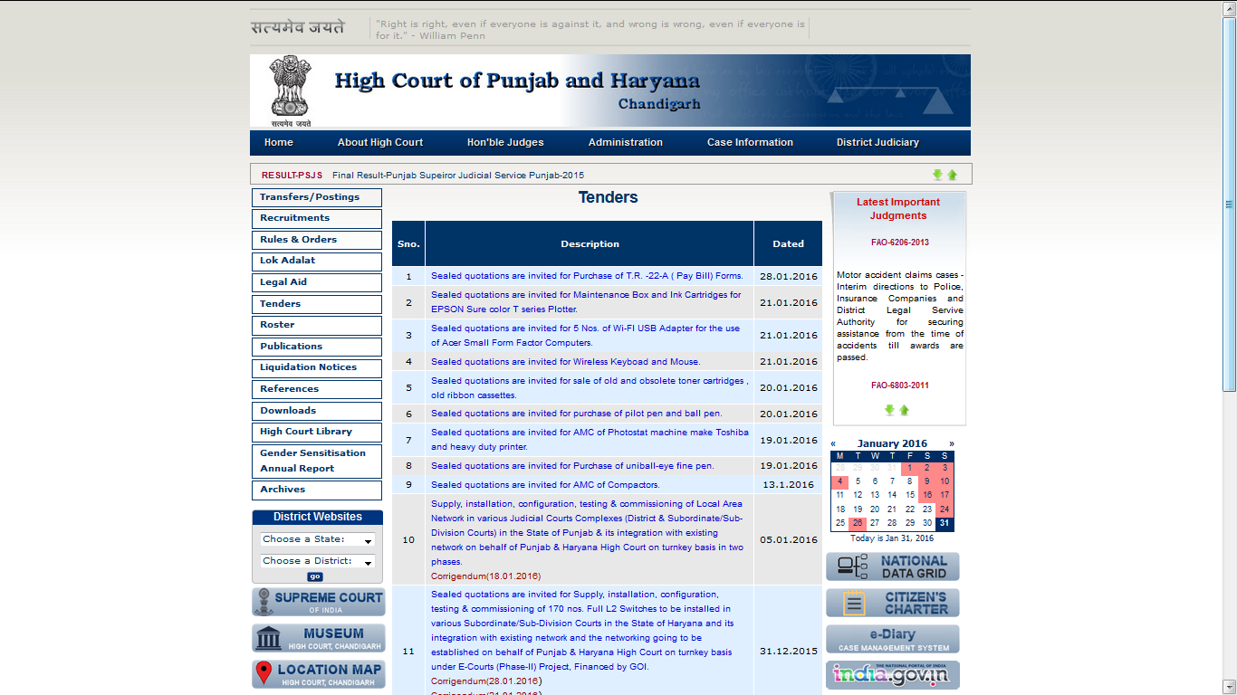

Slide 43
GREVIENCES RESOLUTION S YSTEM
Grievances can be logged online using mobile application interface.
These Grievances are further escalated to concerned authority for the needful action in time.

Slide 44








VIDEO CONFERENCING
  Monitoring
  System Training
  Time saved
  Saving on T.A. and D.A.

Slide 45
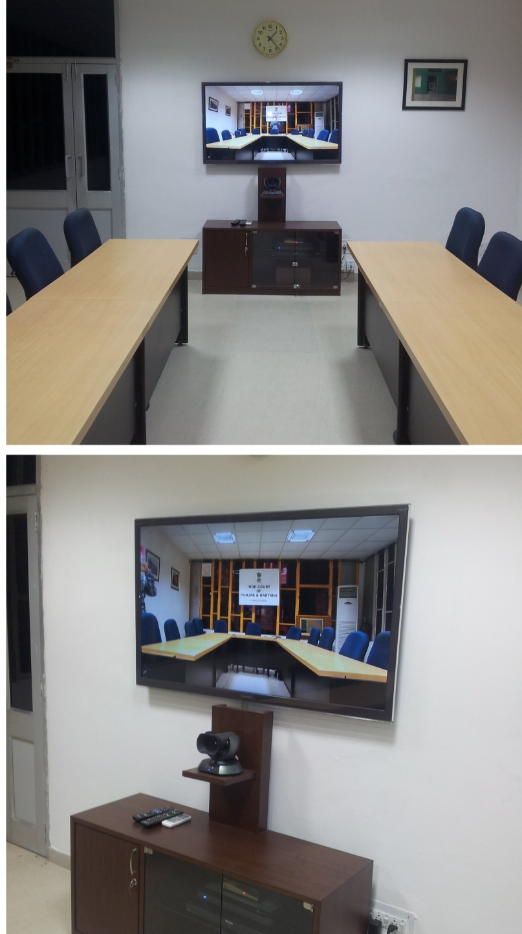

VIDEO CONFERENCING

Slide 46
USE OF VC FOR MEDIATION AND LEGAL AID
Mediation and Legal Aid Monitoring System
Software to monitor Legal Aid has been developed so as to monitor the Legal Aid process which is available using Mobile Application interface.
This specific software in conjunction with software video conferencing provides a new paradigm in the process of Mediation and Legal Aid.

Slide 47



Use of Audio / Video Training Material on WhatsApp
Group of Nodal officers to communicate tentative date and time for remand work or recording of evidence through video conferencing.
SMS & Mobile
To notify last minutes changes.

Slide 48
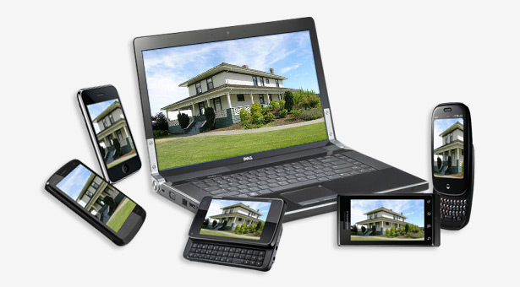
3. SECURITY : REMOTE VIDEO SURVEILLANCE

Slide 49
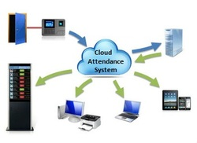
MONITERING ATTENDANCE THROUGH BIOMETRIC SYSTEM SYNCRONISED WITH MOBILE

Slide 50
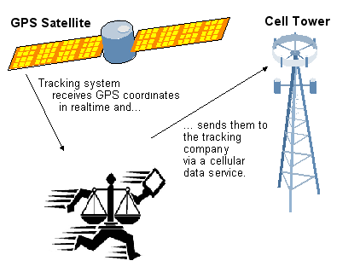
PROCESS SERVING THROUGH USE OF GPS
GPS tracking has become a popular. Process Service can be tracked by using combination of GPS, biomatric and camera tech.

Slide 51
e-STAMPING
e-Stamping is secured way of paying stamp duty through online process. Same is Tamper Proof, can be verified online 24 x 7, has Unique Identification Number and saves money as exact Court Fee can be affixed without going for a particular denomination.
The prevailing system of physical stamp paper/franking can be replaced by E-stamping system.
Stock Holding Corporation of India Limited SHCIL is providing complete solution for affixing e-stamps.
E-Stamp can be purchased online & it can be added to soft as well as hard copy of petition.
Availability of Stamp Duty would be 24 x 7.

Slide 52
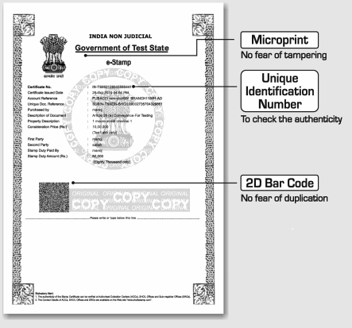

Slide 53
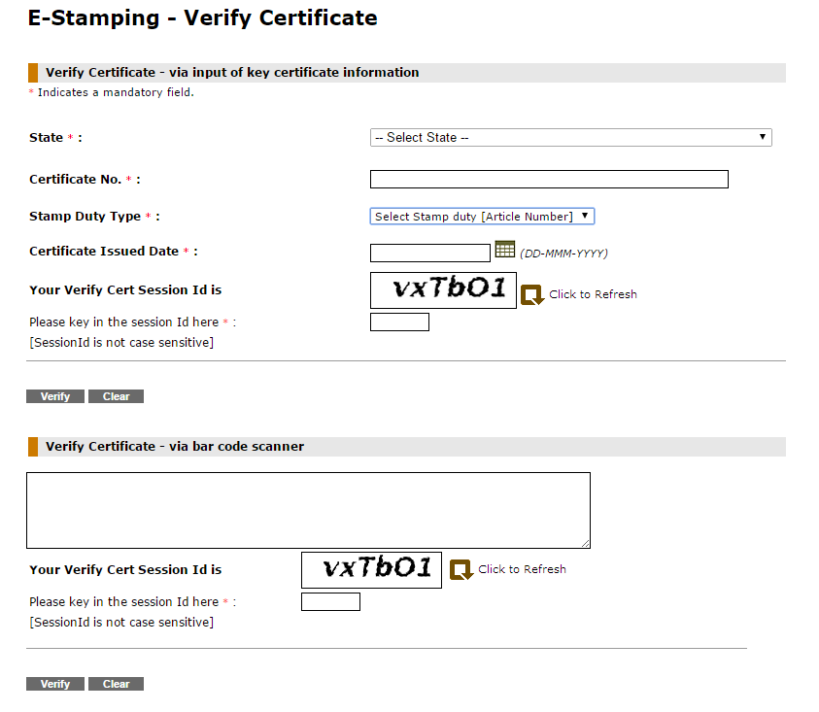

Slide 54
ONLINE TRAFFIC CHALLAN PAYMENT
Convenience to Public.
Payment of fine can be made online through mobile.
Reduces footfall in courts.
Reduces burden on judicial officers / officials.
Brings transparency
Increases fine payment and compliance.

Slide 55
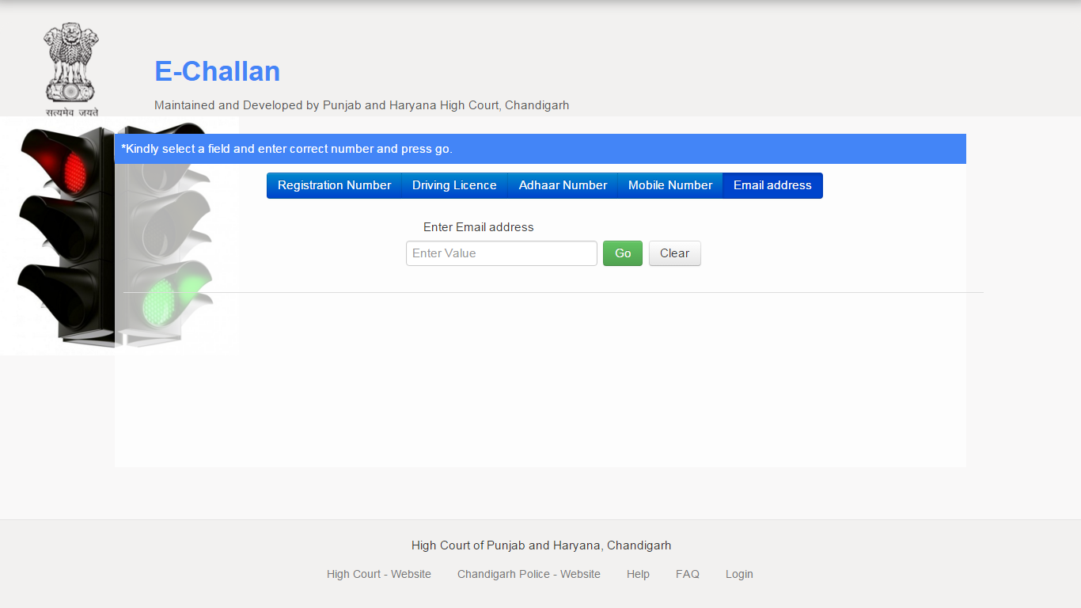
PUBLIC INTERFACE

Slide 56
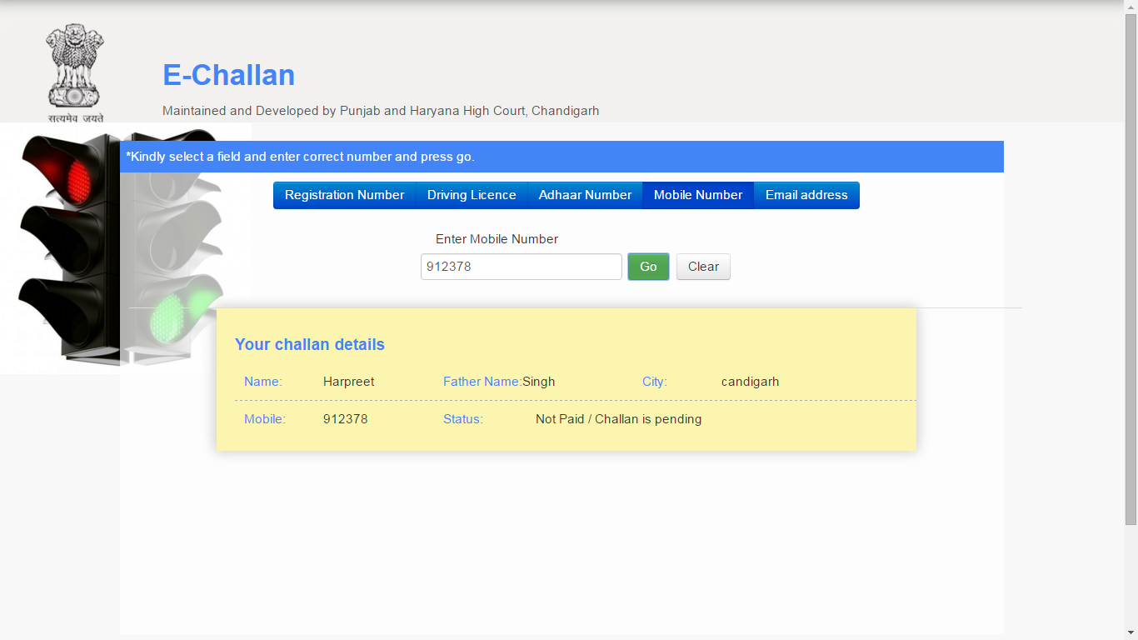
CHALLAN CAN BE FETCH USING ANY OF ABOVE FIELDS I.E REGISTRATION NO., MOBILE NO., VEHICLE NO., E-MAIL ADDRESS AND ADHAAR NUMBER .
SUPPOSE IF WE ENTER MOBILE NUMBER. SCREEN SHOWS AS BELOW

Slide 57
THANK YOU

